Slide 1
ALIMENTARY MODULE PHASE 11
BATCH 25
06th August to 14th SEPTEMBER 2018

Slide 2
Module committee
Committee | Designation | Department
Dr Gayana Mahendra | Co-chairperson | Pathology
Dr Lakmini Wijesooriya | Co-chairperson | Medical Microbiology
Professor J Hewavisenthi | Committee member | Pathology
Dr Anuradha Dassanayake | Committee member | Pharmacology
Professor Madunil Niriella | Committee member | Medicine
Dr Sumudu Kumarage | Committee member | Surgery
Profesor S Rajindrajith | Committee member | Paediatrics
Dr Gayana Gunarathna | Committee member | Parasitology

Slide 3
Teaching /learning activities used in the module
Lectures
Tutorials
Practical sessions
Pathology
Microbiology
Specimen transport –combined session of Pathology, Microbiology and Parasitology
Hands on experience of surgical procedures at clinical skills lab
Problem based learning session (PBL)
Student seminar presentation
Self-directed learning

Slide 4
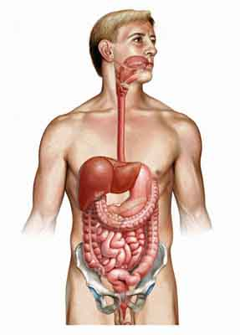
Hand BOOK
Alimentary Module
Phase 2
2018
Uploaded to VLE
Go through intended learning out comes and content areas

Slide 5
Assessment of the module
Assessed at the end of the 6th term of Phase II in Continuous Assessment 10.
24 true/false type questions and 18 single best response questions from the module .
Further assessment will take place at the Unit 4 examination in the form of
Two Short Essay Questions ( 2x SEQ)
Multiple Choice Questions (10 true/false type and 7 single best response questions)
Two Objective Structured Practical Examinations (2x OSPE).

Slide 6
Notices
PBL in chronic liver disease
10 groups
2 sessions in 2nd and 6th week
Groups and venues will be noticed later

Slide 7
Case discussions in common GI disease
8 Groups with the resource person will be displayed at the Pathology notice board
Meet the relevant resource persons early in the course
Identify a case (in wards or in clinics) early
Discuss the case with the resource person
Presentation –brief presentation (6-8 slides) on history, examination and investigations -5minutes
Rest of the time 15-20 minutes –prepare for an active discussion by all group members with the staff members
Best group will be awarded a certificate

Slide 8
Topics for the case discussions
Topic | Resource person | Student Group
Upper GI bleeding | Prof Madunil Niriella | A
Childhood diarrhoea | Prof Shyaman Rajindrajith | B
Blood & mucus diarrhoea in an adult | Prof J Hewavisenthi | C
Focal liver lesion | Dr Anuradha Dasanayake | D
Dysphagia | Dr Sumudu Kumarage | E
Anal pain | Dr Sumudu Kumarage | F
RIF pain | Prof Rohan Siriwardhena | G
Acute abdomen/peritonitis | Prof Rohan Siriwardhena | H

Slide 9
Notices
Pathology practical sessions
All practical sessions except the macroscopy of GI diseases will be held at the computer laboratory.
Macroscopy of GI disease will be held at Department of Parasitology
Practical on specimen collection in GI diseases
Will be held at Department of Microbiology
Microbiology practical -At Department of Microbiology
Sessions on Clinical Skills
Please see the separate schedule given to you. This activity is coordinated by the Department of Medical Education
Public health lectures & tutes and Psychiatry lectures are also included

Slide 10
Notices
Any missed /postponed lecture/other activity to be informed to one of the co-chairpersons of the module – Dr Gayana Mahendra/ Dr Lakmini Wijesooriya by the batch representative /other
Please complete the evaluation form at the end or at the beginning of the next module of the module correctly.

Slide 11


